Slide 1

 | MALLA REDDY COLLEGE OF ENGINEERING (Approved by AICTE, Permanently Affiliated to JNTUH) Recognised under Section 2(f) & 12(B) of the UGC Act 1956, An ISO 9001:2015 Certified Institution. Maisammaguda, Dhulapally, post via Kompally, Secunderabad – 500100
DEPARTMENT OF CSE-DS
MAJOR PROJECT STAGE-2 REVIEW
ACADEMIC YEAR : 2025 – 2026
YEAR : IV SEM : II
DATE : 08/04/2026

Slide 2
Protein Family Classification using Deep Learning Techniques
TEAM MEMBERS
P.MAHIDAR REDDY - 22Q91A67G8
R.DEEPIKA - 22Q91A67H3
SHAIK SAIFUDDIN - 22Q91A67I0
Under the Guidance of
MRS.BHAGYA LAKSHMI
Assistant Professor-CSE-DS

Slide 3
CONTENTS
ABSTRACT
INTRODUCTION
LITERATURE SURVEY
PROBLEM STATEMENT/OBJECTIVE
EXISTING SYSTEM
PROPOSED SYSTEM
FEASABILITY STUDY
HARDWARE REQUIREMENTS AND SOFTWARE REQUIREMENTS
SYSTEM ARCHITECTURE/DESIGN
MODULES USED
IMPLEMENTATION
TEST CASES
SCREENSHOTS/RESULT
CONCLUSION
FUTURE ENHANCEMENT
REFERENCES

Slide 4
ABSTRACT
This project develops a deep learning-based system to classify protein families. Models like GRU, RNN, and LSTM are used to analyze protein sequences and predict their biological functions.
CASP protein sequences from SideChainNet are used for classification. Data preprocessing and feature extraction are performed using Google Colab GPU and saved in NumPy format.
The system includes modules such as registration, dataset upload, preprocessing, model training, and protein family prediction. Users can train models and classify new protein sequences.
Model performance is evaluated using accuracy, precision, recall, and F-score. Results are displayed using graphs and confusion matrices for effective analysis.

Slide 5
INTRODUCTION
Proteins are essential biomolecules that perform functions like metabolism, DNA replication, and cell signaling. Classifying proteins into families helps understand their structure, function, and evolutionary relationships.
Traditional approaches such as sequence alignment and motif-based techniques are time-consuming and struggle with large-scale protein data generated by modern sequencing technologies.
Deep learning models like CNNs, RNNs, and Transformers automatically learn complex patterns from protein sequences, improving classification accuracy and reducing manual feature engineering.
Protein sequences from databases like UniProt and Pfam are encoded into numerical formats and used to train models. Performance is evaluated using accuracy, precision, recall, and F1-score.
This approach supports drug discovery, disease prediction, genomics research, and automated protein annotation, enabling faster and more accurate biological analysis.

Slide 6
LITERATURE SURVEY
1. Transformer-Based Models (Mehta et al., 2024)
Utilizes pre-trained Transformers to capture global dependencies, achieving state-of-the-art results in protein classification.
2. Multi-Task Learning (Wang et al., 2023)
Jointly predicts protein family and function using shared and task-specific layers, improving overall model robustness.
3. Attention-Based DNN (Kim et al., 2022)
Uses self-attention and positional encoding to highlight important residues, improving interpretability and accuracy.
4. Graph-Based Deep Learning (Li et al., 2021)
GNN models protein residues as graph nodes to learn structural relationships, outperforming sequence-only models.
5. DeepProt Framework (Rao et al., 2020) End-to-end deep learning with embeddings, CNNs, and residual layers for efficient and generalizable protein classification.

Slide 7
PROBLEM STATEMENT/OBJECTIVE
Proteins are essential for biological functions, but the rapid growth of protein sequence data makes manual classification difficult. Traditional methods like sequence alignment are time-consuming, require high computational resources, and struggle with large datasets.
The main objective is to develop an automated protein family classification system using deep learning models such as RNN, LSTM, and GRU to analyze protein sequences and extract meaningful features.
The system aims to improve classification accuracy, efficiently handle large datasets, and evaluate performance using accuracy, precision, recall, and F1-score, supporting bioinformatics research and drug discovery.

Slide 8
EXISTING SYSTEM
In existing protein family classification systems, traditional machine learning techniques such as Support Vector Machines (SVM), Decision Trees, k-Nearest Neighbors (k-NN), and Random Forests have been widely used.
These methods typically rely on handcrafted features extracted from protein sequences, such as amino acid composition, dipeptide composition, and physicochemical properties.
Although these models provided decent performance, they struggled to capture long-term dependencies and complex patterns in sequential data, which are crucial for accurate protein family classification.
DISADVANTAGES :-
Manual Feature Engineering: Requires time-consuming manual extraction of protein sequence features..
Poor Sequence Learning: Traditional models cannot capture long-term dependencies in protein sequences.
Low Accuracy & Scalability :Struggles with large datasets and complex biological data..
Limited Scalability: Fails to handle the exponential growth of sequence data efficiently.
No End-to-End Learning:Needs separate steps for feature extraction and classification.

Slide 9
PROPOSED SYSTEM
The proposed system is a deep learning-based framework The system uses RNN, LSTM, and GRU models to classify protein families from raw protein sequences.
Dataset and Feature Processing is Protein sequences from the SideChainNet CASP dataset are processed using Google Colab GPU and saved in NumPy format.
User-Friendly System Modules as The system includes registration, login, dataset processing, model training, and test sequence classification modules.
ADVANTAGES:-
Automated Feature Extraction: Models automatically extract features from protein sequences and capture complex patterns.
Effective Sequence Learning: Accurately captures long-term dependencies and complex patterns within protein data using RNNs, LSTMs, and GRUs.
High Accuracy and Reliability: Provides improved accuracy, precision, recall, and F-score compared to traditional methods.
Scalable and Efficient : Handles large datasets efficiently and allows reuse of extracted features.
End-to-End System : Provides a complete pipeline from data processing to protein family classification.

Slide 10
FEASABILITY STUDY
TECHNICAL FEASIBILITY :
The system uses Python, TensorFlow/PyTorch, Keras, NumPy, and Scikit-learn. The SideChainNet (CASP) dataset is used with GPU support from Google Colab, and deep learning models handle sequential biological data efficiently.
2. OPERATIONAL FEASIBILITY :
The system provides an easy-to-use interface using Streamlit or Flask. It supports user registration, dataset upload, model training, and prediction. The platform is designed for students, researchers, and bioinformaticians.
3. ECONOMIC FEASIBILITY :
No high-cost infrastructure is required, as the system uses open-source tools and free cloud GPU services, with minimal hardware requirements like 4GB RAM and an i3 processor.

Slide 11
HARDWARE REQUIREMENTS AND SOFTWARE REQUIREMENTS
HARDWARE REQUIREMENTS
Processor - Intel Core i5 or above
RAM - 8 GB (Minimum)
Hard Disk - 500 GB or higher
Mouse - Standard Optical Mouse
Monitor - Standard LED/LCD Monitor
Operating System : Windows 10/11 or Linux (e.g., Ubuntu)
Coding Language : Python (3.7 or higher)
Front-End : Streamlit / Flask (for UI)
Back -End : TensorFlow or PyTorch
Framework : Keras, NumPy, Pandas, Scikit-learn
Data Base : Google Colab (for GPU), VS Code, or Jupyter Notebook
SOFTWARE REQUIREMENTS

Slide 12
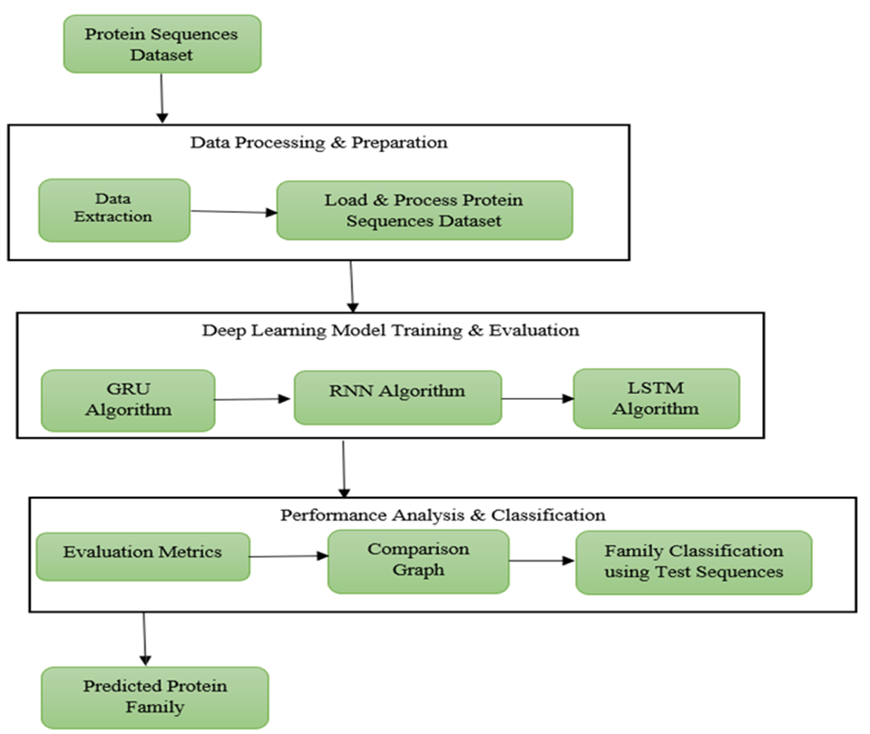
SYSTEM ARCHITECTURE/DESIGN

Slide 13
MODULES USED
Dataset Upload – Allows users to upload TestSequence Dataset for classification.
Preprocessing – Processes and normalizes the dataset for model training.
Model Training –Trains deep learning models like RNN, LSTM, and GRU.
Prediction Module –Predicts protein families from test sequences.
Performance Evaluation – Calculates accuracy, precision, recall, and F1-score.
GUI Interface – Provides an easy-to-use interface for user interaction.

Slide 14
IMPLEMENTATION
MODEL BUILDING:
model = Sequential()
model.add(LSTM(32, input_shape=(80,50), return_sequences=True))
model.add(Dropout(0.5))
model.add(LSTM(16))
model.add(Dense(4, activation='softmax'))
model.compile(optimizer='adam',
loss='categorical_crossentropy',
metrics=['accuracy'])
MODEL TRAINING:
model.fit(X_train, y_train,
epochs=30,
batch_size=32,
validation_data=(X_test, y_test))

Slide 15
.
PREDICTION:
sequences = scaler.transform(test_data)
sequences = np.reshape(sequences, (sequences.shape[0], 80, 50))
prediction = model.predict(sequences)
result = np.argmax(prediction, axis=1)
OUTPUT LOGIN :
labels = ['Globins','Serine Proteases','Immunoglobulin','TIM Barrel']
for i in result:
print("Predicted Protein Family:", labels[i])

Slide 16
TEST CASES
Test Case 1: Valid Protein Sequence Input This test case verifies whether the system correctly accepts valid protein sequence input. The system processes the sequence using the trained deep learning model and predicts the corresponding protein family accurately.
Test Case 2: Invalid / Missing Input This test case checks how the system handles invalid or missing protein sequence data. If the input file is empty or incorrect, the system should display an appropriate error message and prevent prediction.
Test Case 3: User Registration & Dataset Loading This test case verifies whether user registration done or not and the dataset loads correctly into the system. The system should display the total number of protein sequences, features, and available protein families.

Slide 17
.
Test Case 4: User Login This test case ensures that registered users can log in using correct credentials. The system should authenticate the user and allow access to the dashboard. If credentials are incorrect, an error message should be shown.
Test Case 5: Model Training This test case checks whether the deep learning models (RNN, LSTM, GRU) train successfully using the dataset. The system should display accuracy and performance metrics after training.
Test Case 6: System Performance (Multiple Inputs) This test case evaluates the system’s performance when multiple prediction requests are made. The system should handle all requests efficiently without delay, errors, or crashes
Test Case 7: Prediction Output This test case verifies whether the trained model generates correct protein family predictions and displays the output properly in the user interface.

Slide 18
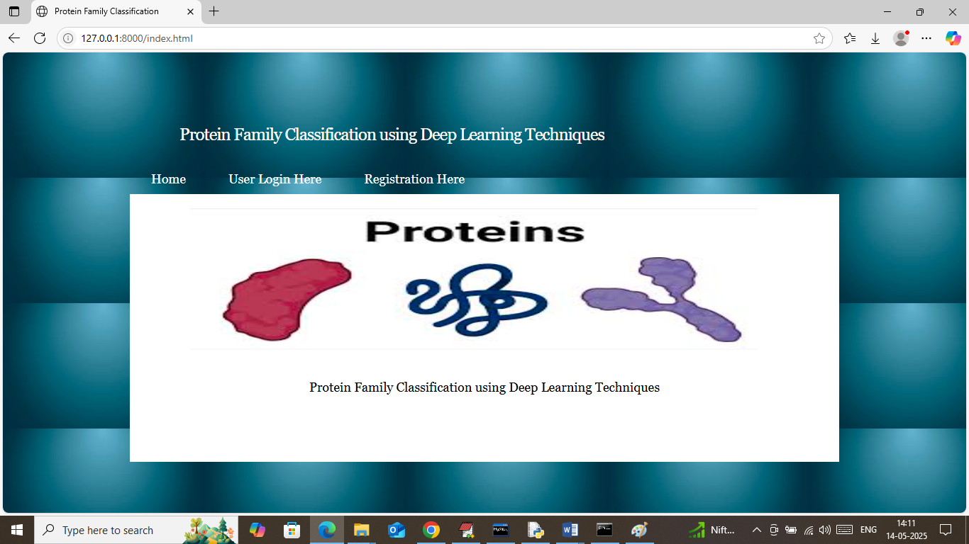
SCREENSHOTS/RESULT
Fig No : 1 Home page

Slide 19
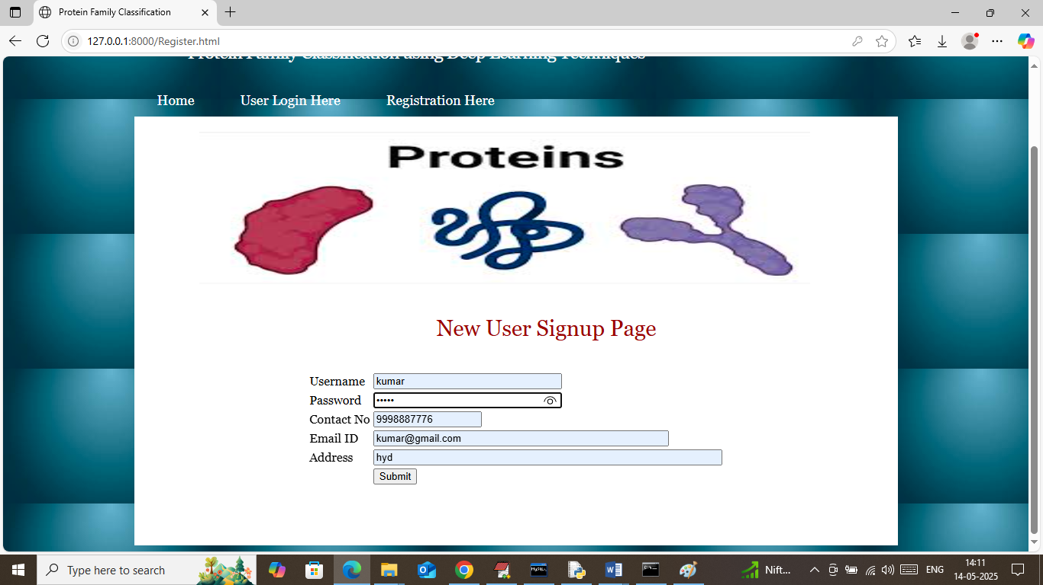
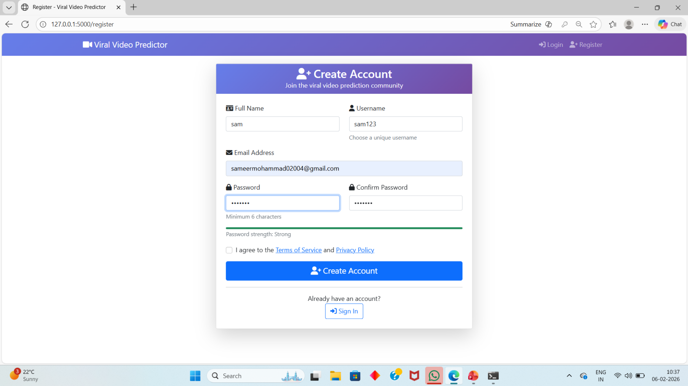
.
Fig No : 2 Sign up page

Slide 20
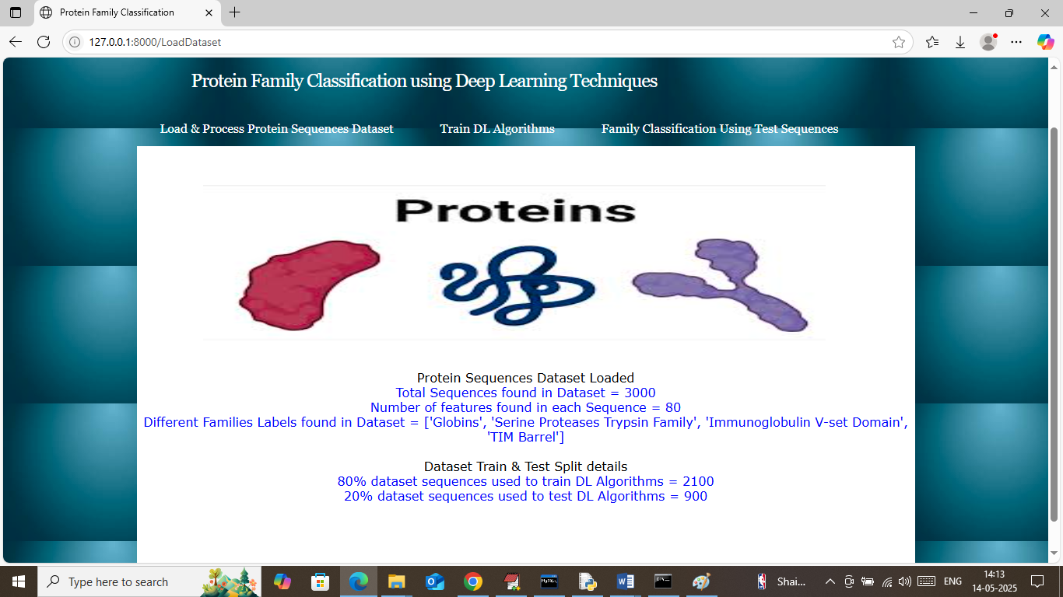
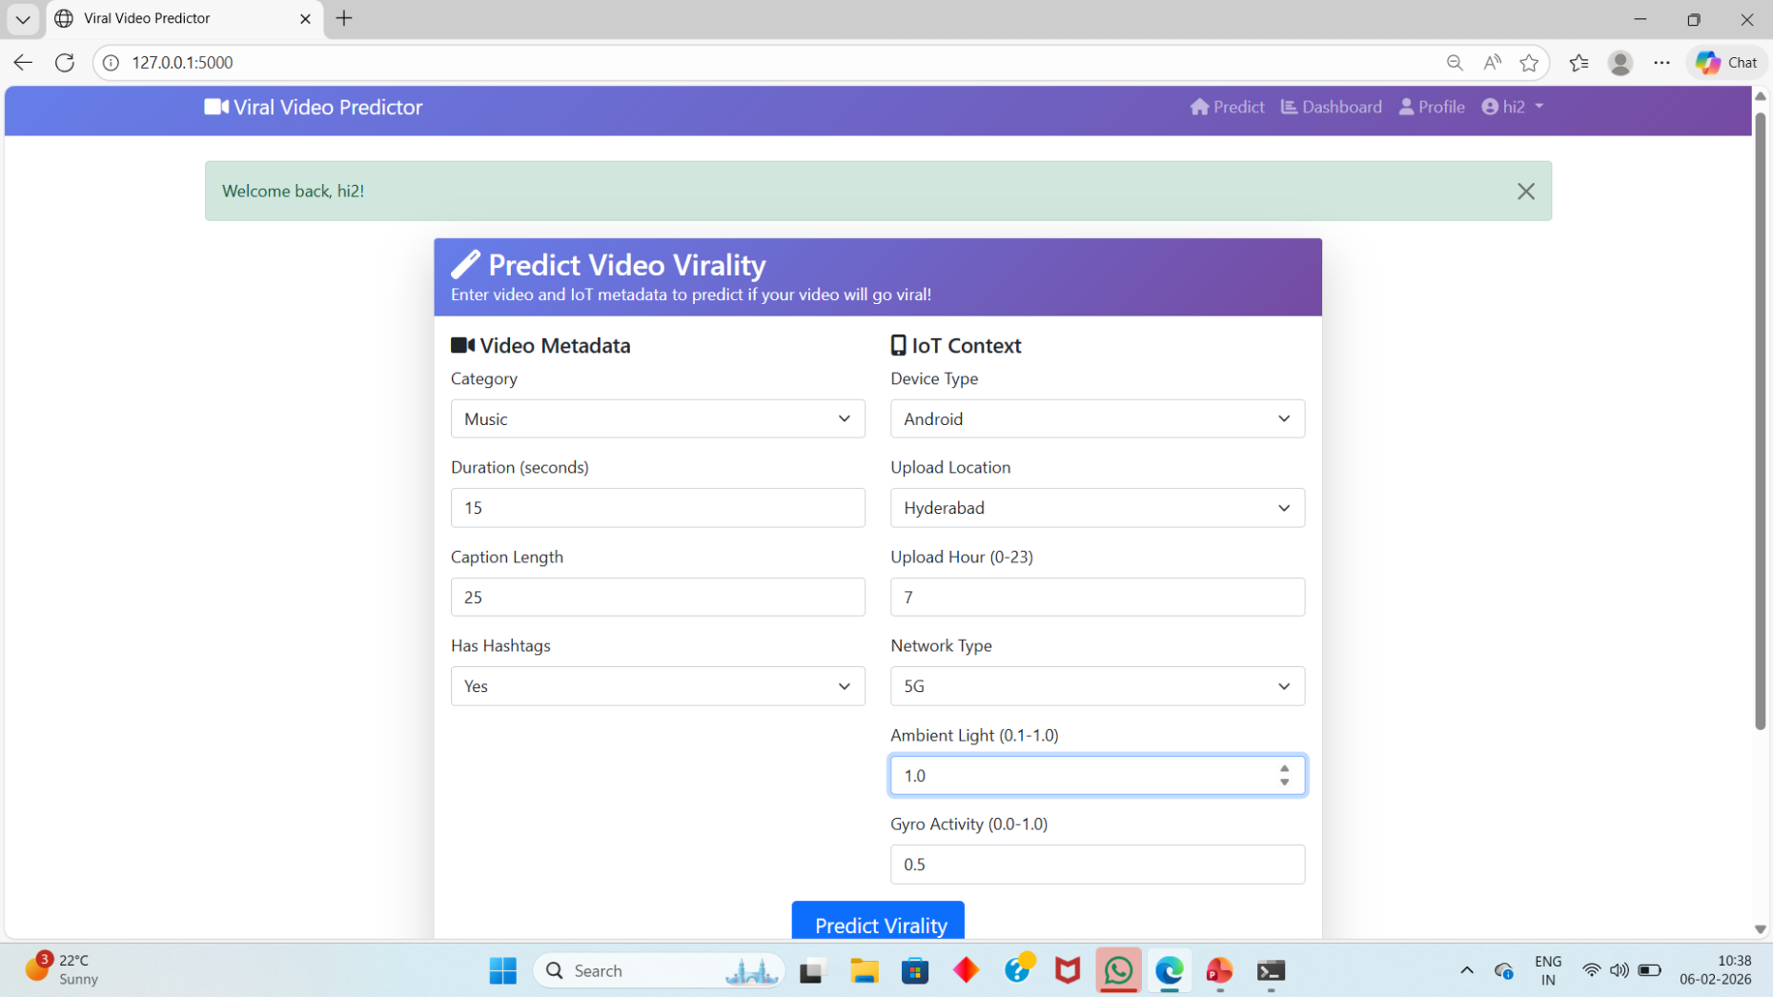
.
Fig No : 3 Dataset Loaded

Slide 21
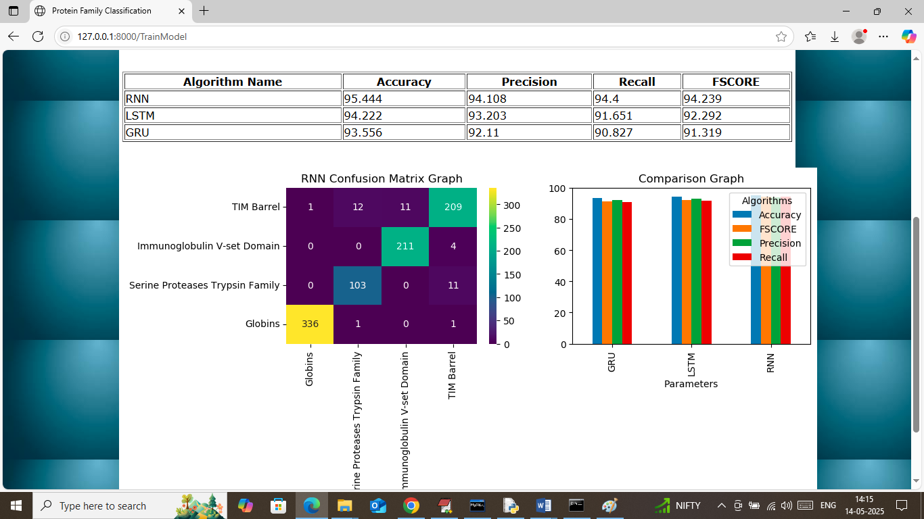
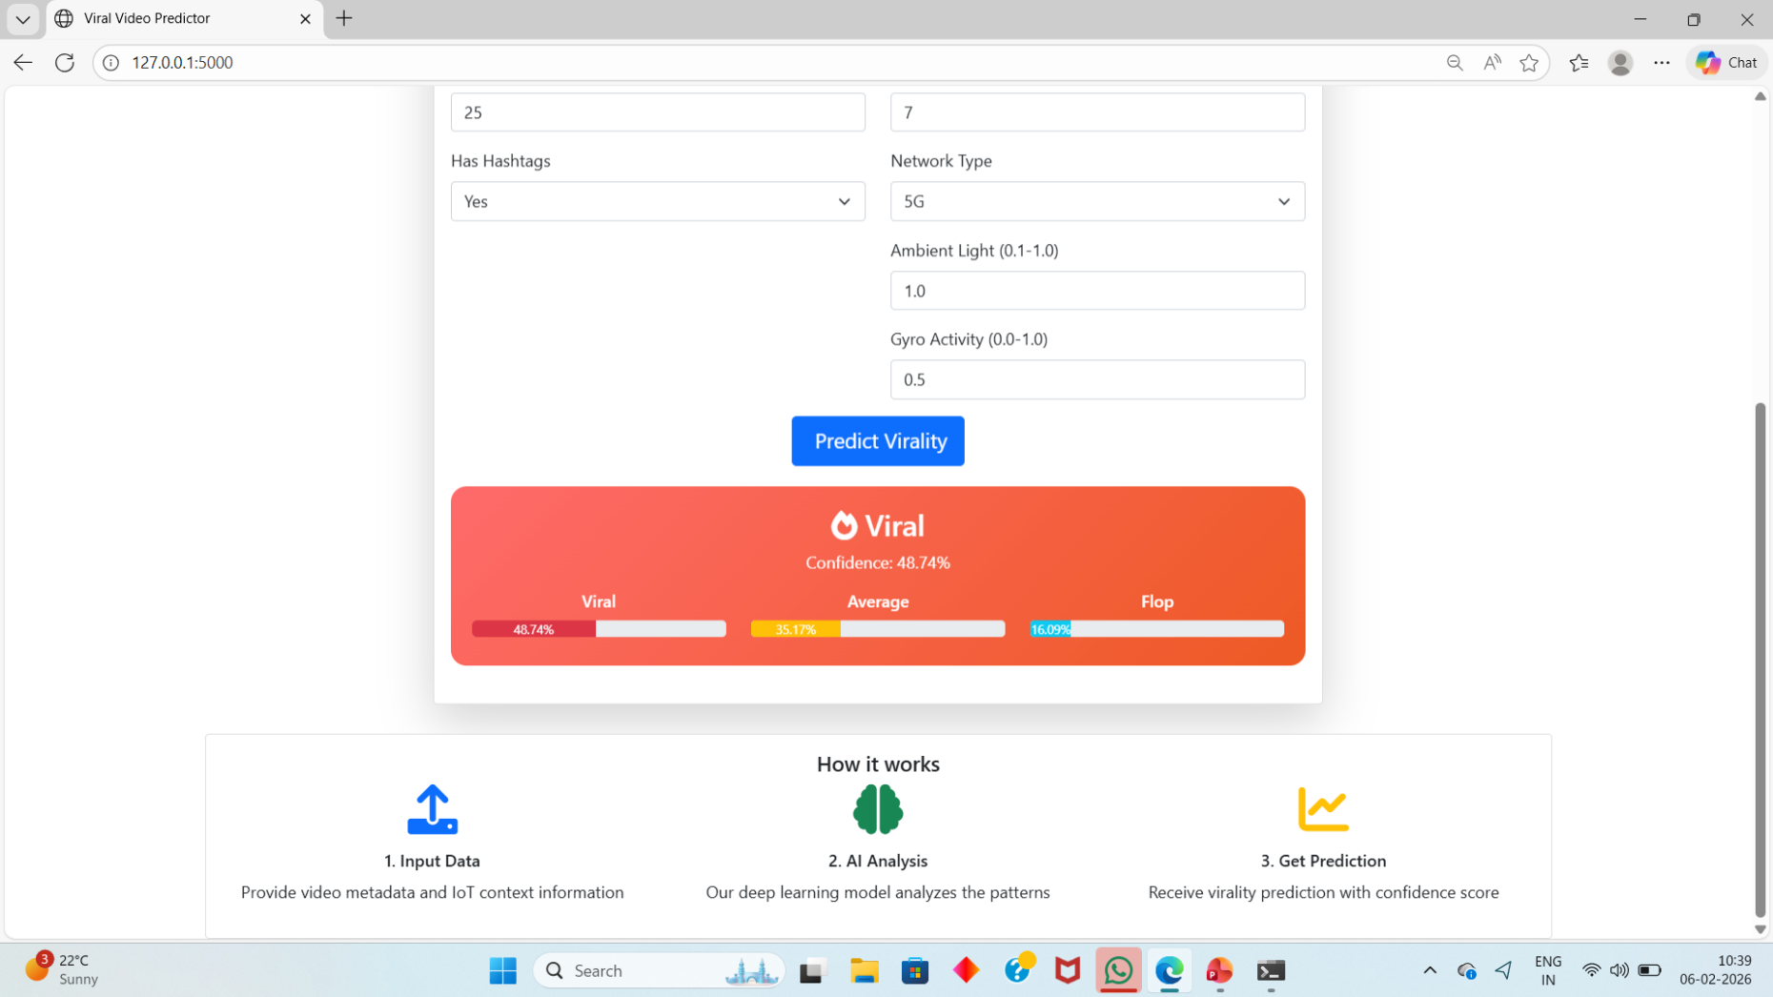
.
Fig No : 4 Training Records

Slide 22
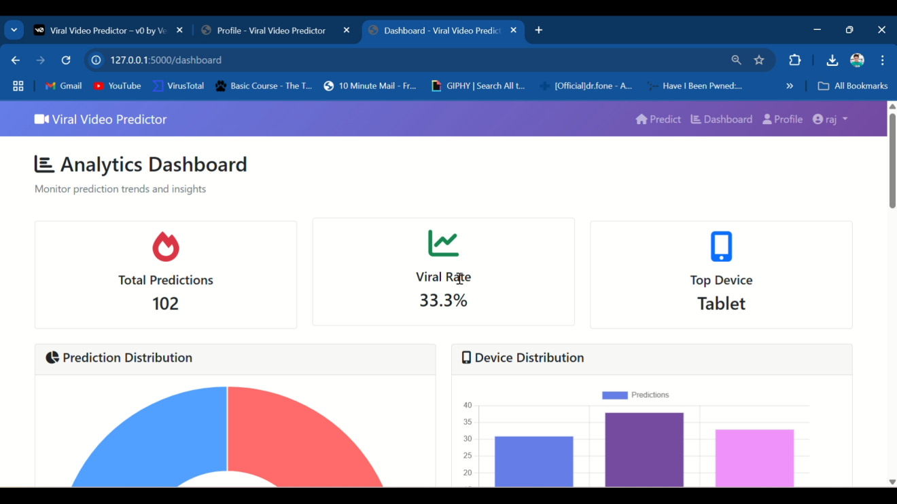
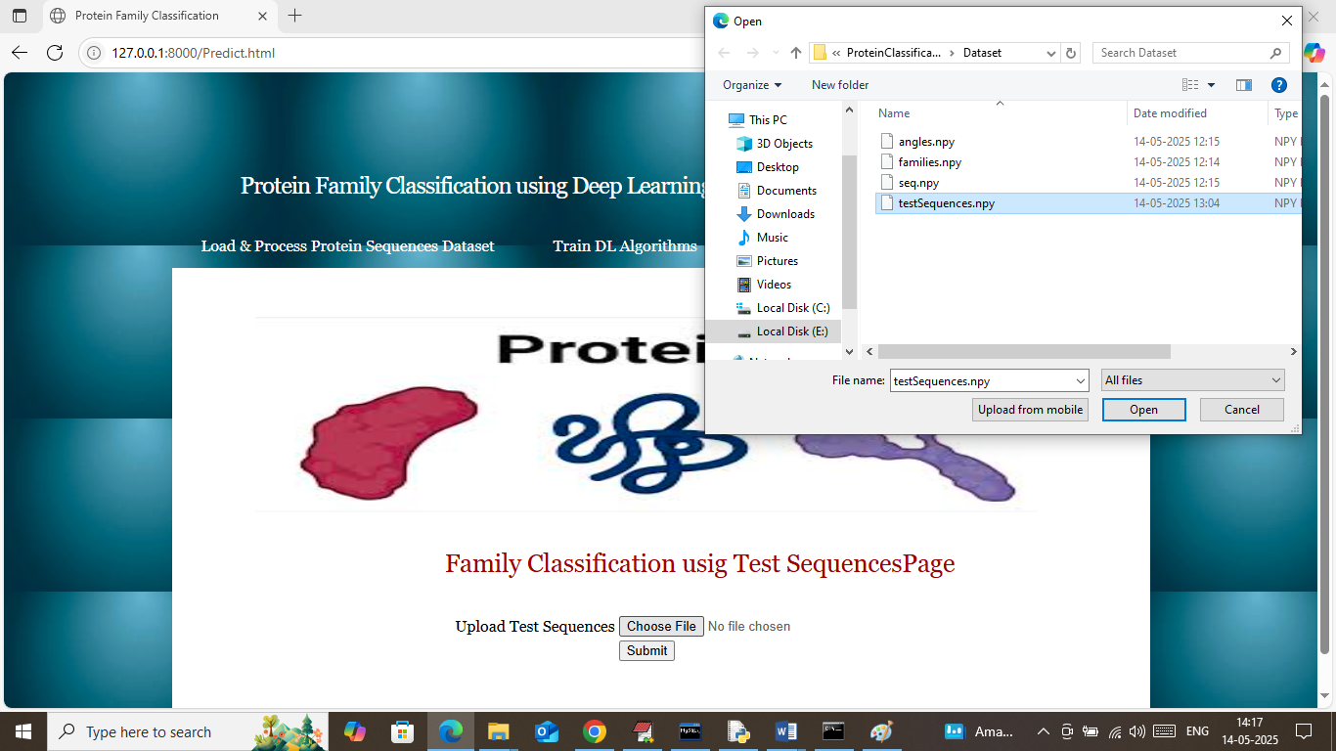
.
Fig No : 5 Uploading TestSequence data

Slide 23
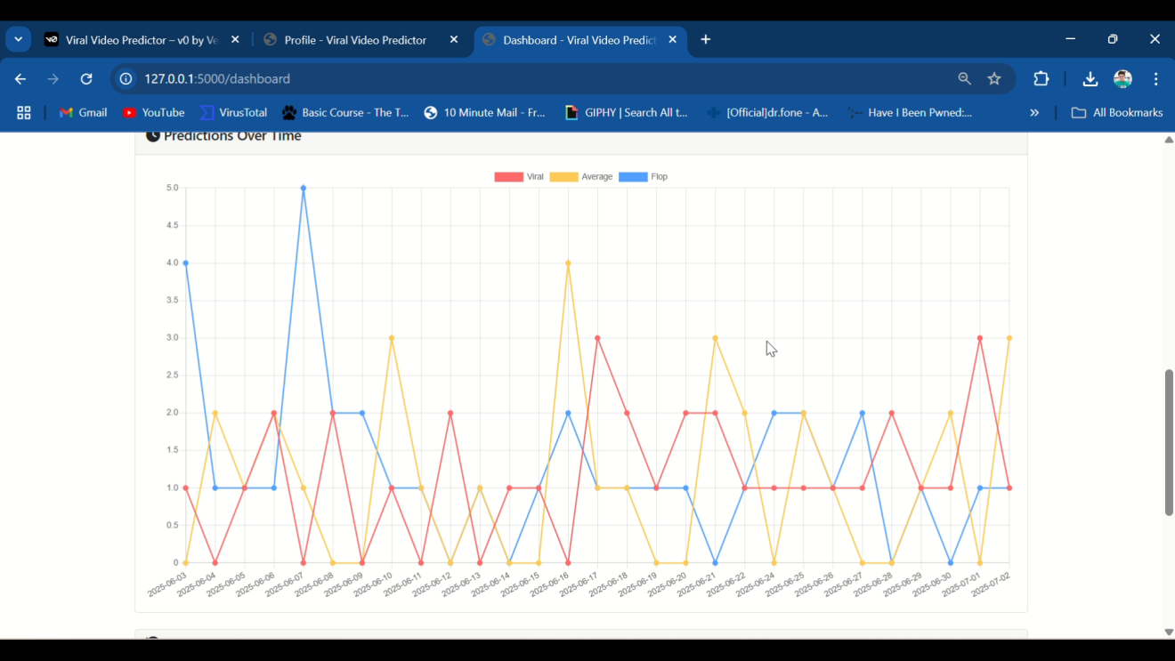
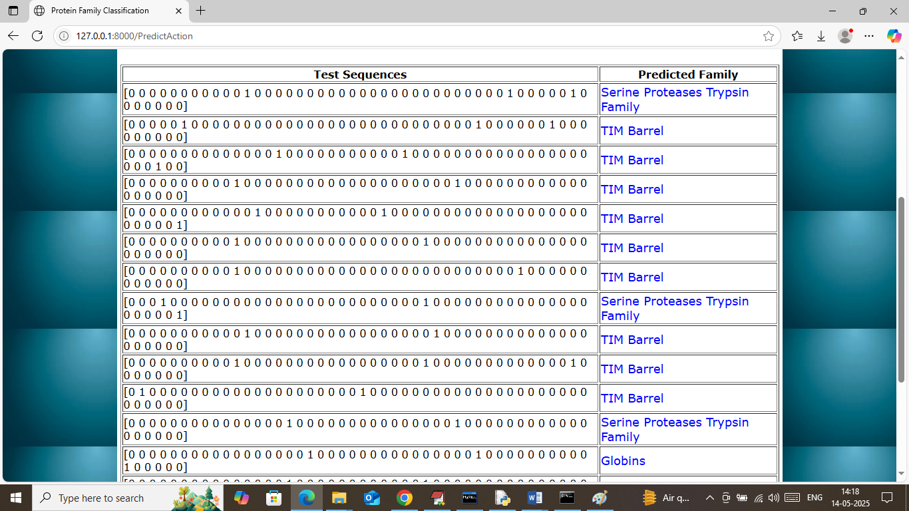
.
Fig No : 6 Predictions of Protien Family

Slide 24
CONCLUSION
This project presented an effective deep learning-based system for automatic protein family classification using biological sequence data. The proposed approach improves accuracy and reduces manual effort in bioinformatics analysis.
Deep learning models such as RNN, LSTM, and GRU were implemented to capture sequential patterns in protein sequences, enabling efficient classification of protein families.
Performance evaluation using accuracy, precision, recall, and F1-score demonstrated that deep learning techniques provide reliable and scalable solutions for protein classification.
The developed system can support bioinformatics research, protein function analysis, drug discovery, and large-scale biological data processing.

Slide 25
FUTURE ENHANCEMENTS
Future Enhancements
The system can be enhanced by integrating advanced deep learning models such as CNN, Transformer, and attention mechanisms to improve protein classification accuracy and capture complex biological patterns.
Future work may include training the model using larger and more diverse protein datasets along with transfer learning techniques to improve generalization and prediction performance.
The system can be extended by incorporating protein structural information, functional annotations, and automated feature extraction methods for better classification results.
A real-time web-based interface with visualization tools and explainable AI techniques can be developed to make the system more accessible and useful for bioinformatics research.

Slide 26
REFERENCES
[1] Vazhayil, A., Vinayakumar, R., & K. P. Soman (2018). DeepProteomics: Protein family classification using shallow and deep networks. arXiv.
[2] Mohammed AlQuraishi et al. (2020). SideChainNet: An all-atom protein structure dataset. MLSB.
[3] D. Sandaruwan & C. T. Wannige (2021). An improved deep learning model for hierarchical classification of protein families. PLoS ONE.
[4] Investigation of protein family relationships with deep learning. (2023). Bioinformatics Advances.
[5] B. Ali et al. (2024). Attention-based CNN-BiLSTM for protein family classification (ProFamNet). arXiv.
[6] R. Zulfiqar et al. (2025). A review on amino acid-based protein classification using supervised AI models. Springer.

